Slide 1
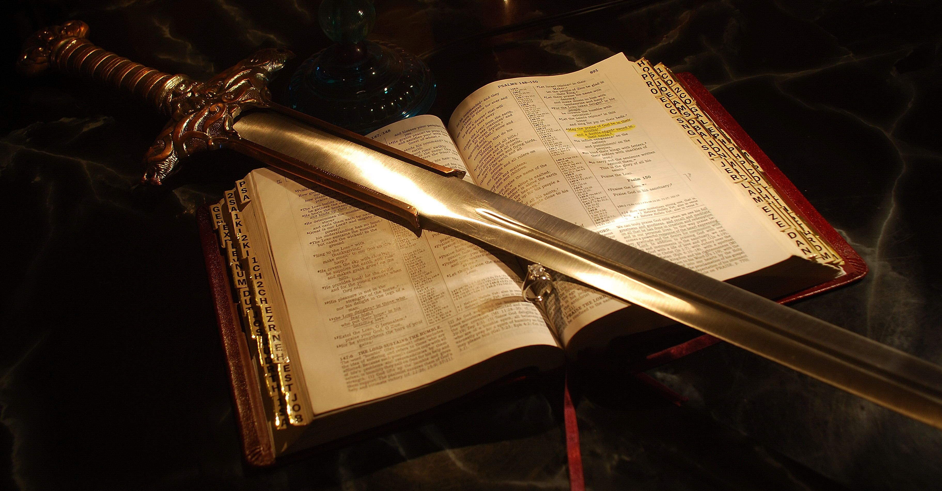
THE BIBLE
SHARPER THAN ANY TWO EDGED SWORD

Slide 2
55 Bible Verses about the Word of God
The Word of God is essentially the teachings, commands, and wisdom imparted in scripture. It is believed by many to be divinely inspired. It’s important to understand these are God’s Words, and Bible verses are not simply a collection of religious stories but an inspired account of God’s relationship with humanity.

Slide 3
B.I.B.L.E.
Biblical instructions before leaving earth
Believers instructions before leaving earth
Best instructions before leaving earth

Slide 4
Hebrews 4:12, “For the word of God is quick, and powerful, and sharper than any two edged sword, piercing even to the dividing asunder of soul and spirit, and of the joints and marrow, and is a discerner of the thoughts and intents of the heart.”

Slide 5
THE WHOLE ARMOR OF GOD
Ephesians 6:11-14, “Put on the whole armour of God, that ye may be able to stand against the wiles of the devil. For we wrestle not against flesh and blood, but against principalities, against powers, against the rulers of the darkness of this world, against spiritual wickedness in high places. Wherefore take unto you the whole armour of God, that ye may be able to withstand in the evil day, and having done all, to stand. Stand therefore, having your loins girt about with truth, and having on the breastplate of righteousness; …”

Slide 6
Ephesians 6:15-19, “… And your feet shod with the preparation of the gospel of peace; Above all, taking the shield of faith, wherewith ye shall be able to quench all the fiery darts of the wicked. And take the helmet of salvation, and the sword of the Spirit, which is the word of God: Praying always with all prayer and supplication in the Spirit, and watching thereunto with all perseverance and supplication for all saints; And for me, that utterance may be given unto me, that I may open my mouth boldly, to make known the mystery of the gospel”

Slide 7
2 Timothy 2:6-11, “The husbandman that laboureth must be first partaker of the fruits. Consider what I say; and the Lord give thee understanding in all things. Remember that Jesus Christ of the seed of David was raised from the dead according to my gospel: Wherein I suffer trouble, as an evil doer, even unto bonds; but the word of God is not bound. Therefore I endure all things for the elect’s sakes, that they may also obtain the salvation which is in Christ Jesus with eternal glory. It is a faithful saying: For if we be dead with him, we shall also live with him”

Slide 8
Titus 2:4-8, “That they may teach the young women to be sober, to love their husbands, to love their children, To be discreet, chaste, keepers at home, good, obedient to their own husbands, that the word of God be not blasphemed. Young men likewise exhort to be sober minded. In all things shewing thyself a pattern of good works: in doctrine shewing uncorruptness, gravity, sincerity, Sound speech, that cannot be condemned; that he that is of the contrary part may be ashamed, having no evil thing to say of you.”

Slide 9
1 Peter 1:22-25, “Seeing ye have purified your souls in obeying the truth through the Spirit unto unfeigned love of the brethren, see that ye love one another with a pure heart fervently: Being born again, not of corruptible seed, but of incorruptible, by the word of God, which liveth and abideth for ever. For all flesh is as grass, and all the glory of man as the flower of grass. The grass withereth, and the flower thereof falleth away: But the word of the Lord endureth for ever. And this is the word which by the gospel is preached unto you.”

Slide 10
1 John 2:14-18, “I have written unto you, fathers, because ye have known him that is from the beginning. I have written unto you, young men, because ye are strong, and the word of God abideth in you, and ye have overcome the wicked one. Love not the world, neither the things that are in the world. If any man love the world, the love of the Father is not in him. For all that is in the world, the lust of the flesh, and the lust of the eyes, and the pride of life, is not of the Father, but is of the world. And the world passeth away, and the lust thereof: but he that doeth the will of God abideth for ever. Little children, it is the last time: and as ye have heard that antichrist shall come, even now are there many antichrists; whereby we know that it is the last time.”

Slide 11
Romans 16:17, “Now I beseech you, brethren, MARK them which cause divisions and offences contrary to the doctrine which ye have learned; and avoid them.”
Philippians 3:17-18, “Brethren, be followers together of me, and MARK them which walk so as ye have us for an ensample. (For many walk, of whom I have told you often, and now tell you even weeping, that they are the enemies of the cross of Christ”

Slide 12
For the word of God is quick, and powerful, and sharper than any two edged sword.
Put on the whole armour of God
and the sword of the Spirit, which is the word of God.
To teach.
Show a pattern of good works.
MARK them which walk so as ye have us for an ensample.

Slide 13
HEARING
Matthew 11:15, “He that hath ears to hear, let him hear”
Matthew 13:15, “For this people’s heart is waxed gross, and their ears are dull of hearing , and their eyes they have closed; lest at any time they should see with their eyes, and hear with their ears, and should understand with their heart, and should be converted, and I should heal them.”
Matthew 13:43, “Then shall the righteous shine forth as the sun in the kingdom of their Father. Who hath ears to hear , let him hear.”
BELIEVING
Luke 8:12-13, “Those by the way side are they that hear; then cometh the devil, and taketh away the word out of their hearts, lest they should believe and be saved. They on the rock are they, which, when they hear, receive the word with joy; and these have no root, which for a while believe, and in time of temptation fall away.”

Slide 14
REPENTANCE
Jonah 3:9-10, “Who can tell if God will turn and repent , and turn away from his fierce anger, that we perish not? And God saw their works, that they turned from their evil way; and God repented of the evil, that he had said that he would do unto them; and he did it not.”
Revelation 3:3, “Remember therefore how thou hast received and heard, and hold fast, and repent . If therefore thou shalt not watch, I will come on thee as a thief, and thou shalt not know what hour I will come upon thee.”
CONFESSION
Ezra 10:11-12, “Now therefore make confession unto the LORD God of your fathers, and do his pleasure: and separate yourselves from the people of the land, and from the strange wives. Then all the congregation answered and said with a loud voice, As thou hast said, so must we do.”
Romans 10:10-11, “For with the heart man believeth unto righteousness; and with the mouth confession is made unto salvation. For the scripture saith, Whosoever believeth on him shall not be ashamed.”

Slide 15
BE BAPTIZED
Mark 16:15-16, “And he said unto them, Go ye into all the world, and preach the gospel to every creature. He that believeth and is baptized shall be saved; but he that believeth not shall be damned.”
Acts 2:38-39, “Then Peter said unto them, Repent, and be baptized every one of you in the name of Jesus Christ for the remission of sins, and ye shall receive the gift of the Holy Ghost. For the promise is unto you, and to your children, and to all that are afar off, even as many as the Lord our God shall call.”
Acts 8:36-39, “And as they went on their way, they came unto a certain water: and the eunuch said, See, here is water; what doth hinder me to be baptized ? And Philip said, If thou believest with all thine heart, thou mayest. And he answered and said, I believe that Jesus Christ is the Son of God. And he commanded the chariot to stand still: and they went down both into the water, both Philip and the eunuch; and he baptized him. And when they were come up out of the water, the Spirit of the Lord caught away Philip, that the eunuch saw him no more: and he went on his way rejoicing.”

Slide 16
LIVE FAITHFULLY
3 John 2-8, “Beloved, I wish above all things that thou mayest prosper and be in health, even as thy soul prospereth. For I rejoiced greatly, when the brethren came and testified of the truth that is in thee, even as thou walkest in the truth. I have no greater joy than to hear that my children walk in truth. Beloved, thou doest faithfully whatsoever thou doest to the brethren, and to strangers; Which have borne witness of thy charity before the church: whom if thou bring forward on their journey after a godly sort, thou shalt do well: Because that for his name's sake they went forth, taking nothing of the Gentiles. We therefore ought to receive such, that we might be fellowhelpers to the truth.”
Ephesians 2:1-5, “And you hath he quickened, who were dead in trespasses and sins; Wherein in time past ye walked according to the course of this world, according to the prince of the power of the air, the spirit that now worketh in the children of disobedience: Among whom also we all had our conversation in times past in the lusts of our flesh, fulfilling the desires of the flesh and of the mind; and were by nature the children of wrath, even as others. But God, who is rich in mercy, for his great love wherewith he loved us, Even when we were dead in sins, hath quickened us together with Christ, (by grace ye are saved;)”

